Slide 1
Automatic Music Transcription for Monophonic Piano Music
via Image Recognition
CS 229 Machine Learning Final Project
2017/12/11
Chen Cen ccen@stanford.edu
An Jiang jianga@stanford.edu

Slide 2
Abstract
In this project, we tried to tackle the problem of Automatic Music Transcription (AMT) using a new approach that transforms the music note detection problem into a image recognition problem using Convolutional Neural Networks (CNN). The monotonic piano soundtracks are processed into images of spectrums with constant-Q transform. Then we use an image recognition algorithm with Tensorflow to build and train a CNN that can differentiate and label the corresponding piano note from the spectrums. In the end, we have successfully developed a machine learning model that can automatically transcribe piano tracks into music scores.

Slide 3
Data
We used MIDI Aligned Piano Sounds (MAPS) dataset which is a database for MIDI-annotated piano recordings. It contains real piano recordings and corresponding MIDI file and labels indicating the on and off time of each note. For the model training purpose, we only utilized the recordings of single isolated notes that are in the MIDI code range [21:108]. The tracks are mapped to frequency spectrums with constant-Q transform and we generate a 32x32 thumbnail of the spectrogram for each 0.05 sec of the track. The images along with the ground truth of what note do they represent are combined into a cPickle data package which will be fed into the training model directly.

Slide 4
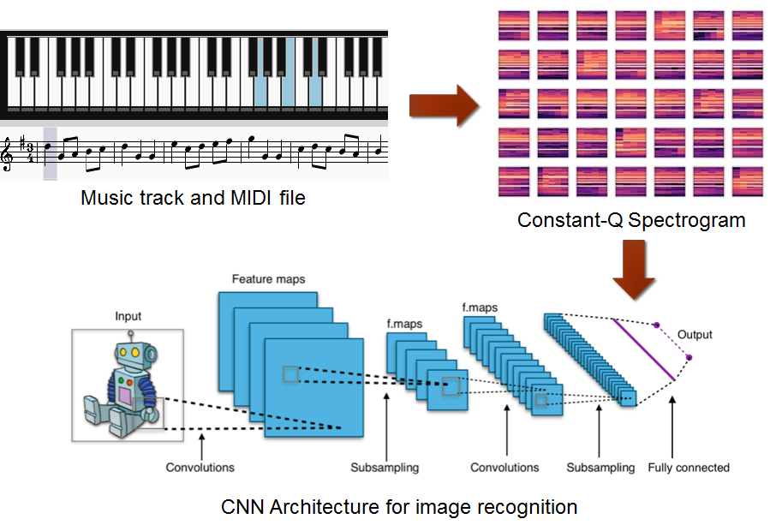

Slide 5
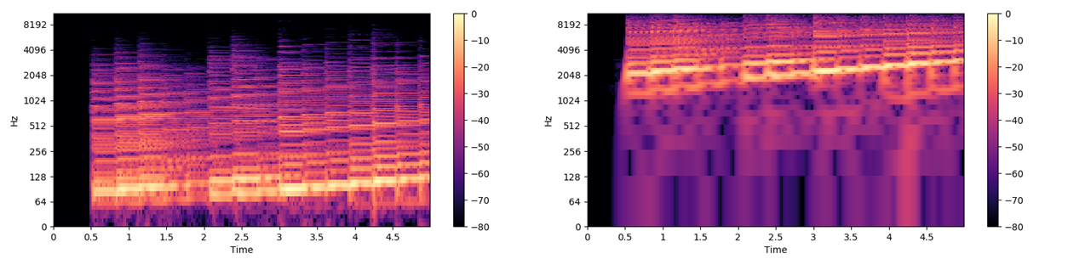
Features
Spectrograms are the most standard way of visualizing sounds, which maps the music notes to frequency domain. However, most of the notes are located in low frequency range. Constant-Q transform provides better time-frequency resolutions at these range compared to Short-Time Fourier Transform (STFT). From the plots above we can see the bottom quarter of the spectrogram is extended for Constant-Q and make the individual notes more extinguishable.

Slide 6
Models
conv1
pool1
norm1
conv2
pool2
norm2
local3
local4
softmax_linear
conv1
pool1
norm1
local3
local4
softmax_linear
Notes:
Our initial training model applies from [0] [1] which was originally used to solve the CIFAR-10[3] problem. It is a multi-layer architecture consisting of alternating convolutions and nonlinearities. Specifically, it consists of two CNN layers with two fully connected layer with ReLU activation function, followed by a 10-way softmax output.
The algorithm maximizes the multinomial logistic regression objective, which is equivalent to maximizing the average across training cases of the log-probability of the correct label under the prediction distribution.
To Adopt this model to our problem, we made the following changes and tweaks
*) Don’t apply image shuffle to the data set.
*) The original CIFAR dataset contains complicated real life objects/animals, to reduce overfit, the model randomized the brightness and contrast of images, some images are inverted horizontally. We tried to train our model without these shuffles
*) Don’t shrink image size
*) blah

Slide 7
Results
We have conducted several experiments on the image processing procedure, learning parameters and CNN structure to improve the performance of the model. All the data below are obtained by training the neural network with the same dataset with more than 8000 images after 5000 steps while the data are splited for training and testing with the ration of 4:1.
Model | Cross Entropy (L2) | Total Loss | Test Accuracy
Original CNN and parameters | 0.356 | 0.52 | 0.782
Learning rate fast decay | 0.228 | 1.23 | 0.76
No image distortion | 0.192 | 0.356 | 0.773
Larger image size | 0.14 | 0.23 | 0.823

Slide 8
Results
We can see that the original network used for image classification is not performing so badly though still not as good as the accuracy achieved by the original article (86%). Thus, we have tested several methods to improve the result: to make the cross entropy converges faster, we tried to modify the decay rate of the learning rate; to reduce the noise of the input, we skipped the random distortion of the images before feeding to the model; to enhance the quality of the dataset, we increased the resolution of the images. As a result, improving the quality of the images have increased the test accuracy the most.

Slide 9
Discussion
This is where you share your thoughts about your project. (Hopefully you have a few interesting interpretations!) Briefly summarized what just happened. Briefly explain whether or not you expected your results. If your results were good, explain why. If they were not good, explain why. (6 sentences max)

Slide 10
Future
There are still room for improvements on dataset processing and the CNN model to further increase the accuracy. We can apply more contrasts on the spectrogram to make the different notes more distinguishable. The neural network can be modified with more convolutional layers and less pooling layers to solve the note classification problem better. Furthermore, we can explore the polyphonic music transcription problem using the same methodology.

Slide 11
Reference

